Slide 1

Optimizing Zend Framework
Juozas “Joe” Kaziukėnas
http://juokaz.com / juozas@juokaz.com / @juokaz

Slide 2
Who am I?
Juozas Kaziukėnas, Lithuanian
You can call me Joe
3 years in Edinburgh, UK
CEO of Web Species Ltd
Software developer, consultant and evangelist
Open source developer for Zend Framework, Doctrine…
Conferences speaker
More info in http://juokaz.com and twitter @juokaz

Slide 3
Who are you?
Zend Framework users?
Scaling problems?
Generally interested in PHP performance issues?
Want to bash Zend Framework?
Symfony users?

Slide 4
This talk will not necessary teach you how to make your applications faster, it will show you how to understand them.

Slide 5
Things we are going to talk about
“Normal” PHP code
What makes it slow?
How people find slow parts?
A key to optimizing Zend Framework applications
How slow it really is?
Practical tips

Slide 6
“Normal” PHP code

Slide 7
“Normal” PHP code
Zend Framework is different from one-file php websites
Building another Facebook
Overhead
Bloated Frameworks
Zend Framework is not for “script kiddies”

Slide 8
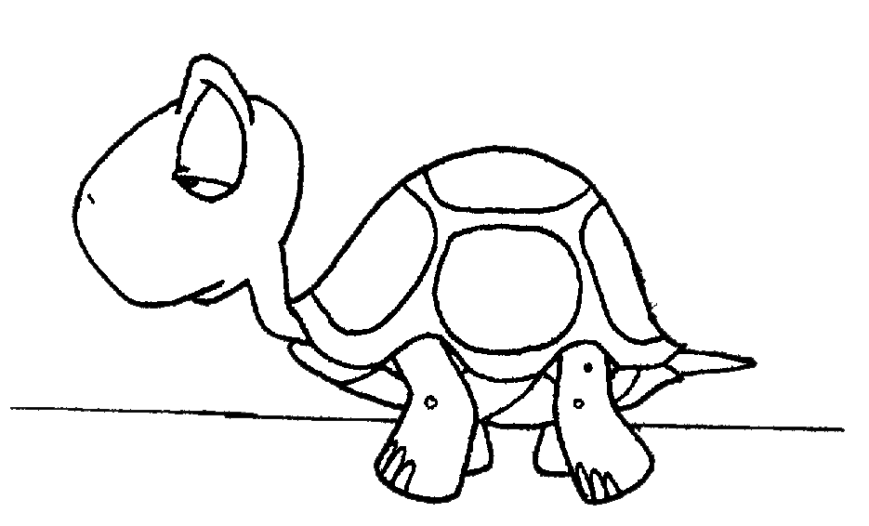
Zend Framework app will *never* be as fast as one-file PHP website

Slide 9
What makes it slow?

Slide 10

Usually *you* make it slow!

Slide 11
Usually you make it slow?!
First of all:
Not having favicon.ico
Not using APC cache
Not caching anything
Not reading Zend Framework performance guide (http://bit.ly/x0zIf)
Blaming framework for poor SQL queries and other bottlenecks
… a dozen more
Those can be fixed easily, just read the manual (RTFM!)

Slide 12
Solving some of those issues
Caching is easy, but don’t overuse it
Do as much as possible/needed asynchronously
Gearman (http://gearman.org/)
HTTP server optimizations
Lighttpd, Nginx
Won’t fix all of the problems

Slide 13
How people find slow parts?

Slide 14
Possible ways
Crashing servers
Logging
SQL queries
Slow requests
Memory usage behavior
Static analysis
Profiling
Benchmarking

Slide 15

Benchmarking
Main tools:
Apache Benchmark tool
Siege
We are interested in:
Requests per second
Average latency
Results, around 50 r/s for a basic ZF app

Slide 16
Profiling
Really easy to setup, only requires xdebug PHP extension by Derick Rethans
Analyzer: KCacheGrind, WebGrind etc.
Much more faster and true than static code analysis
Can spot any problem anywhere

Slide 17
A key to optimizing Zend Framework applications

Slide 18

Zend Framework by default is *slow*

Slide 19
Why is it slow by default?
Application structure made for configurability and fast building, not for large scale websites
Works in most cases, gets your site up and running
Documentation/examples are unclear
Has a performance limit:
Zend_Application
Autoloading and plugin loading
All the magic inside views and controllers

Slide 20

Compromise between performance and ease-of-use

Slide 21
How slow it really is?

Slide 22
Average – 30 requests per second. Or 2.5 million page views per day. Do you need that many?

Slide 23
If you do
Requires much more experience that just building an app
Dark magic
Use the power of Zend Framework – it’s components as you want
Engineering task
A lot more easier with Zend Framework 2.0
Rules of Optimization: Rule 1: Don't do it. Rule 2 (for experts only): Don't do it yet.
Michael A. Jackson

Slide 24
Practical tips

Slide 25
Autoloading
Use only autoloading
Strip require_once calls
ZF library folder first in include_path
Use ZF 2 classmap loader
Only if you have PHP 5.3
Post by Matthew http://bit.ly/lJEjSy

Slide 26
Cache
Zend_Application config loading
Parsing application.ini is slow and useless
Zend_Db metadata
View helpers as methods in App_View
Suggested by Rob Allen

Slide 27
More
Zend_Application is slowish
Modules are even more
Zend_Translate lookups
Less objects to load – faster load time
Anything else is application dependent

Slide 28

Migrate to PHP 5.3
Smaller memory usage
Overall faster
ZF 2.0 components can be used
Migration to ZF 2.0 in a future

Slide 29
Conclusion
Speed may wary A LOT
Cache, cache, cache
Requires experience to get it to perform better than other frameworks
Use latest PHP version (5.3 works great!)
Monitor performance by logging
Profile application before release
Improvise

Slide 30

If all you have is a hammer, everything looks like a nail

Slide 31
Thanks!
Juozas Kaziukėnas
http://juokaz.com
juozas@juokaz.com
twitter: @juokaz
Rate this talk at http://joind.in/3020

